Slide 1
INFORMATION SECURITY [3 0 0 3] ICT : 3126

Slide 2
Outline
General idea behind symmetric-key ciphers.
Traditional symmetric-key ciphers: Not used today, study them for several reasons.
simpler than modern ciphers and easier to understand.
Give the basic foundation of cryptography and encipherment: To better understand modern ciphers.
Provide the rationale for using modern ciphers, because the traditional ciphers can be easily attacked using a computer. Ciphers that were secure in earlier eras are no longer secure in this computer age.
DES
AES
.

Slide 3
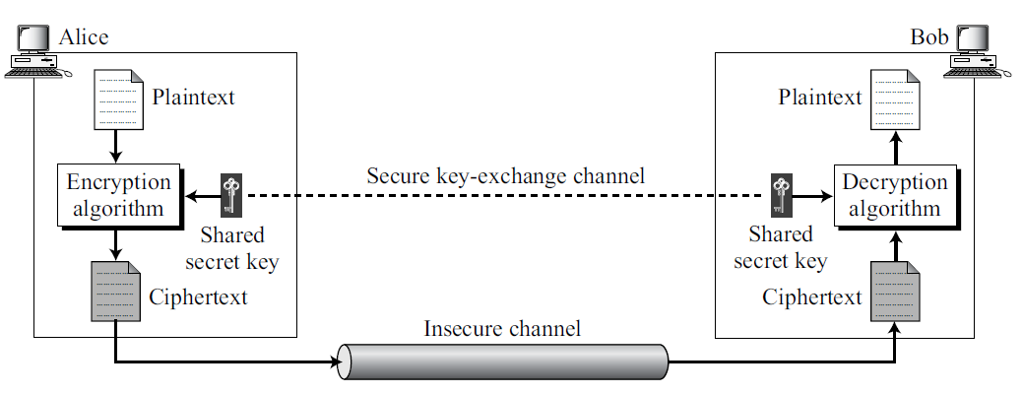
3.1 INTRODUCTION
The general idea behind a symmetric-key cipher.
.

Slide 4
An entity, Alice, can send a message to another entity, Bob, over an insecure channel with the assumption that an adversary, Eve, cannot understand the contents of the message by simply eavesdropping over the channel.
Plaintext: Original message from Alice to Bob.
Ciphertext: The message that is sent through the channel.
Encryption algorithm and a shared secret key: To create the ciphertext from the plaintext..
Decryption algorithm and the shared secret key: To create the plaintext from ciphertext.
We refer to encryption and decryption algorithms as ciphers.
A key is a set of values (numbers) that the cipher operates on.
.

Slide 5
Encryption and decryption algorithms are inverses of each other.
If P is the plaintext, C is the ciphertext, and K is the key,
Encryption algorithm E_{k}(x) creates the ciphertext from the plaintext;
Decryption algorithm D_{k}(x) creates the plaintext from the ciphertext.
.

Slide 6

E_{k}(x) and D_{k}(x) are inverses of each other: they cancel the effect of each other if they are applied one after the other on the same input.
According to Kerckhoff’s principle, it is better to make the encryption and decryption public but keep the shared key secret.
.

Slide 7
This means that Alice and Bob need another channel, a secured one, to exchange the secret key.
Alice and Bob can meet once and exchange the key personally. Secured channel here is the face-to-face exchange of the key.
Trust a third party to give them the same key.
Create a temporary secret key using another kind of cipher-asymmetric-key ciphers- (discussed later).
Assumption: There is an established secret key between Alice and Bob.
.

Slide 8
Another element in symmetric-key encipherment is the number of keys.
Alice needs another secret key to communicate with another person, say David.
If there are m people in a group who need to communicate with each other, how many keys are needed?
.

Slide 9
Another element in symmetric-key encipherment is the number of keys.
Alice needs another secret key to communicate with another person, say David.
If there are m people in a group who need to communicate with each other, how many keys are needed?
(m × (m − 1))/2
.

Slide 10
Kerckhoff’s Principle
Based on Kerckhoff’s principle, one should always assume that the adversary, Eve, knows the encryption/decryption algorithm.
Resistance of the cipher to attack must be based only on the secrecy of the key.
Guessing the key should be so difficult that there is no need to hide the encryption/decryption algorithm.
.

Slide 11
Cryptanalysis
Cryptography: The science and art of creating secret codes.
cryptanalysis : The science and art of breaking those codes.
In addition to studying cryptography techniques, we also need to study cryptanalysis techniques.
Not to break the codes, but to learn how vulnerable our cryptosystem is.
The study of cryptanalysis helps us create better secret codes.
.

Slide 12
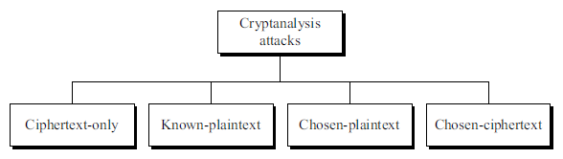
4 common types of cryptanalysis attacks.
.

Slide 13
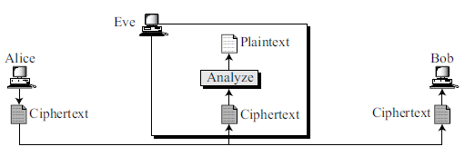
Ciphertext-Only Attack
Eve has access to only some ciphertext.
She tries to find the corresponding key and the plaintext.
Assumption : Eve knows the algorithm and can intercept the ciphertext.
Various methods can be used in ciphertext-only attack. Some are:
Brute-Force Attack
Statistical Attack
Pattern Attack
.

Slide 14
Brute-Force Attack
In the brute-force method or exhaustive-key-search method, Eve tries to use all possible keys.
Assumption : Eve knows the algorithm and knows the key domain (the list of all possible keys).
Was a difficult task in the past; it is easier today using a computer.
To prevent this type of attack, the number of possible keys must be very large.
.

Slide 15
Statistical Attack
The cryptanalyst can benefit from some inherent characteristics of the plaintext language to launch a statistical attack.
Example :
Letter E is the most frequently used letter in English text.
Cryptanalyst finds the mostly-used character in the ciphertext and assumes that the corresponding plaintext character is E.
To prevent this type of attack, the cipher should hide the characteristics of the language.
.

Slide 16
Pattern Attack
A cryptanalyst may use a pattern attack to break the cipher.
It is important to use ciphers that make the ciphertext look as random as possible.
.

Slide 17
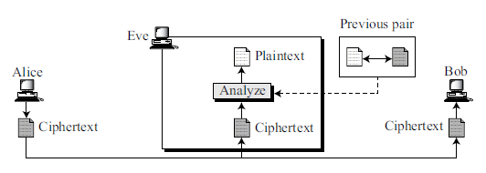
Known-Plaintext Attack
Eve has access to some plaintext/ciphertext pairs in addition to the intercepted ciphertext that she wants to break.
.

Slide 18
Known-Plaintext Attack (contd)
The plaintext/ciphertext pairs have been collected earlier.
For example, Alice has sent a secret message to Bob, but she has later made the contents of the message public.
Eve has kept both the ciphertext and the plaintext to use them to break the next secret message from Alice to Bob, assuming that Alice has not changed her key.
It is less likely to happen because Alice may have changed her key or may have not disclosed the contents of any previous messages.
.

Slide 19
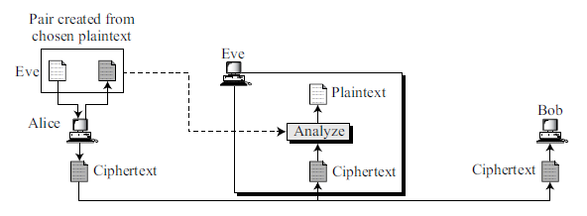
Chosen-Plaintext Attack
Chosen-plaintext attack is similar to the known-plaintext attack, but the plaintext/ ciphertext pairs have been chosen by the attacker herself.
This can happen, if Eve has access to Alice’s computer.
.

Slide 20
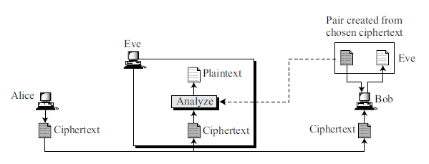
Chosen-Ciphertext Attack
The chosen-ciphertext attack is similar to the chosen-plaintext attack, except that Eve chooses some ciphertext and decrypts it to form a ciphertext/plaintext pair.
This can happen if Eve has access to Bob’s computer.
.

Slide 21
Categories of Traditional Ciphers
Two broad categories: substitution ciphers and transposition ciphers.
substitution cipher: Replace one symbol in the ciphertext with another symbol;
transposition cipher: Reorder the position of symbols in the plaintext.
.

Slide 22
3.2 SUBSTITUTION CIPHERS
A substitution cipher replaces one symbol with another.
For example, we can replace letter A with letter D, and letter T with letter Z. If the symbols are digits (0 to 9), we can replace 3 with 7, and 2 with 6.
Substitution ciphers can be categorized as either monoalphabetic ciphers or polyalphabetic ciphers.
.

Slide 23
Monoalphabetic Ciphers
Character (or a symbol) in the plaintext is always changed to the same character (or symbol) in the ciphertext regardless of its position in the text.
Relationship between letters in the plaintext and the ciphertext is one-to-one.
.

Slide 24
Example : The cipher is probably monoalphabetic.
.

Slide 25

Example : The cipher is not monoalphabetic.
.

Slide 26
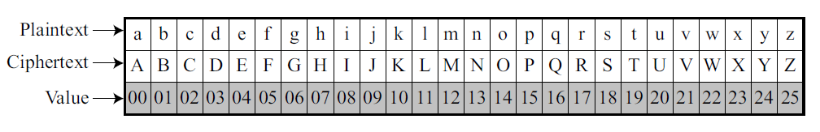
Additive Cipher (shift cipher or Caesar cipher)
Simplest monoalphabetic cipher is the additive cipher.
Assume: plaintext consists of lowercase letters (a to z), and ciphertext consists of uppercase letters (A to Z).
To apply mathematical operations on the plaintext and ciphertext, assign numerical values to each letter.
Representation of plaintext and ciphertext characters in Z26
.

Slide 27
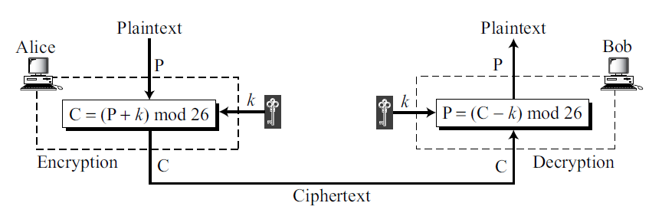
Additive Cipher (contd)
.

Slide 28
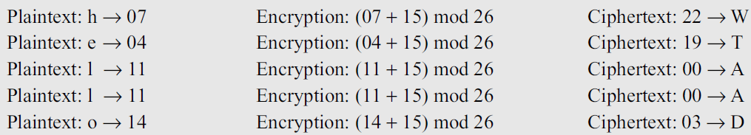
Additive Cipher (contd)
Example : Use the additive cipher with key = 15 to encrypt the message “hello”.
The result is “WTAAD”.
The cipher is monoalphabetic.
.

Slide 29
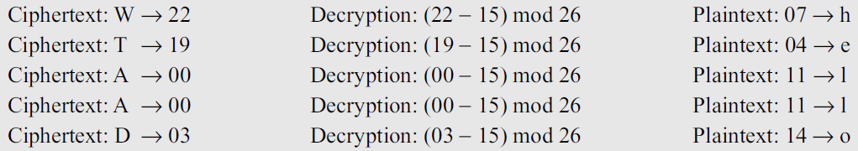
Additive Cipher (contd)
Example : Use the additive cipher with key = 15 to decrypt the message “WTAAD”.
The result is “hello”.
The operation is in modulo 26, which means that a negative result needs to be mapped to Z₂₆ (for example −15 becomes 11).
.

Slide 30
Additive ciphers are sometimes referred to as shift ciphers or Caesar cipher.
Caesar Cipher
Julius Caesar used an additive cipher to communicate with his officers.
Caesar used a key of 3 for his communications.
.

Slide 31
Cryptanalysis
Additive ciphers are vulnerable to ciphertext-only attacks using exhaustive key searches (brute-force attacks).
Key domain of the additive cipher is very small; there are only 26 keys.
One of the keys, zero, is useless. This leaves only 25 possible keys.
Eve can easily launch a brute force attack on the ciphertext.
.

Slide 32
Example : Eve has intercepted the ciphertext “UVACLYFZLJBYL”. Show how she can use a brute-force attack to break the cipher.
.

Slide 33
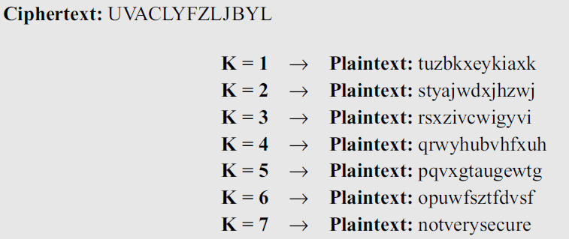
Example : Eve has intercepted the ciphertext “UVACLYFZLJBYL”. Show how she can use a brute-force attack to break the cipher.
Solution : Eve tries keys from 1 to 7. With a key of 7, the plaintext is “not very secure”, which makes sense
.

Slide 34
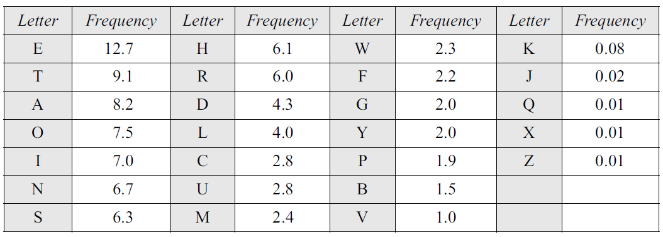
Additive ciphers are also subject to statistical attacks.
This is especially true if the adversary has a long ciphertext.
Adversary can use the frequency of occurrence of characters for a particular language.
Table : frequency for an English text of 100 characters
.

Slide 35
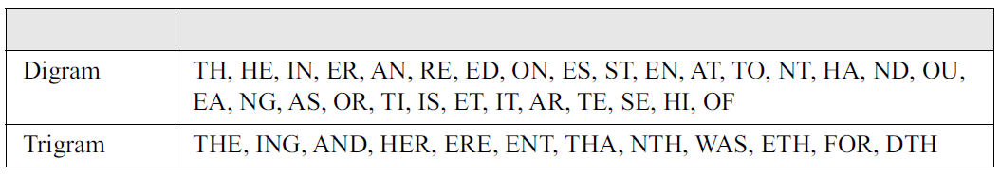
Sometimes it is difficult to analyze a ciphertext based only on information about the frequency of a single letter;
we may need to know the occurrence of specific letter combinations.
Table : Most common 2-letter groups (digrams) and 3-letter groups (trigrams) for the English text .
.

Slide 36
Example : Eve has intercepted the following ciphertext. Using a statistical attack, find the plaintext.
Solution
When Eve tabulates the frequency of letters in this ciphertext, she gets: I =14, V =13, S =12, and so on.
Most common character is I with 14 occurrences. Character I in the ciphertext probably corresponds to the character e in plaintext.
This means key = 4. Eve deciphers the text to get
.

Slide 37
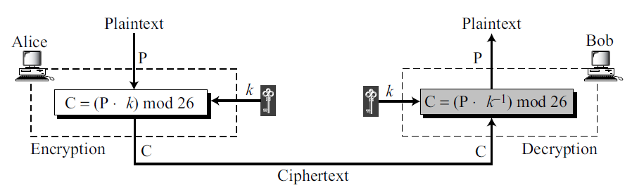
Multiplicative Ciphers
Encryption algorithm specifies multiplication of the plaintext by the key and the decryption algorithm specifies division of the ciphertext by the key.
Since operations are in Z₂₆, decryption here means multiplying by the multiplicative inverse of the key.
The key needs to belong to the set Z₂₆* to guarantee that encryption and decryption are inverses of each other.
.

Slide 38
In a multiplicative cipher, the plaintext and ciphertext are integers in Z₂₆
the key is an integer in Z₂₆*
.

Slide 39
Example : What is the key domain for any multiplicative cipher?
Solution : The key needs to be in Z₂₆*.
This set has only 12 members: 1, 3, 5, 7, 9, 11, 15, 17, 19, 21, 23, 25.
gcd(n,26)=1
.

Slide 40
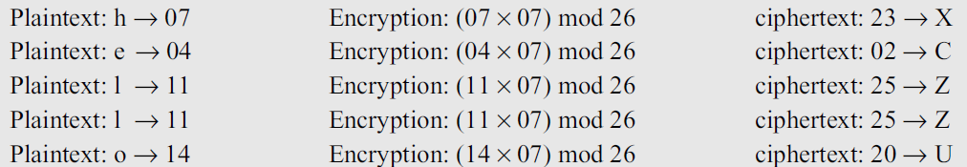
Use multiplicative cipher to encrypt the message “hello” with a key of 7.
.

Slide 41
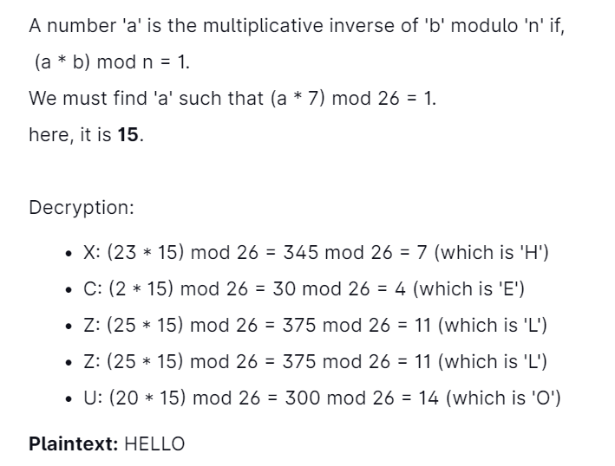
Example 3.8 : We use a multiplicative cipher to encrypt the message “hello” with a key of 7. The ciphertext is “XCZZU”.
.

Slide 42
Affine Cipher
Combination of the additive and multiplicative ciphers with a pair of keys.
The first key is used with the multiplicative cipher; the second key is used with the additive cipher.
The affine cipher is actually two ciphers, applied one after another.
Ie. C = (P × k₁ + k₂) mod 26 and P = ((C − k₂) × k₁⁻¹) mod 26.
Whenever we use a combination of ciphers we should be sure that each one has an inverse at the other side of the line and that they are used in reverse order in the encryption and decryption.
If addition is the last operation in encryption, then subtraction should be the first in decryption.
.

Slide 43
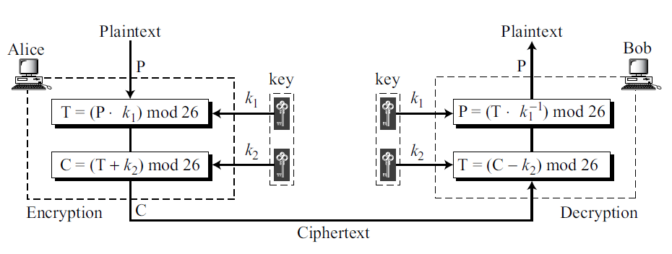
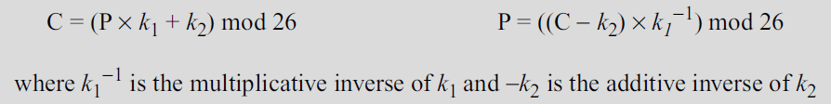
Affine Cipher (contd)
In the affine cipher, the relationship between the plaintext P and the ciphertext C is
.

Slide 44
Affine Cipher (contd)
Example : The affine cipher uses a pair of keys in which the first key is from Z₂₆* and the second is from Z₂₆.
The size of the key domain is 26 × 12 = 312.
.

Slide 45
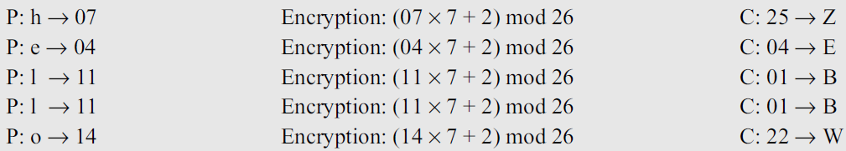
Affine Cipher (contd)
Example : Use an affine cipher to encrypt the message “hello” with the key pair (7, 2).
Solution : We use 7 for the multiplicative key and 2 for the additive key. We get “ZEBBW”.
.

Slide 46
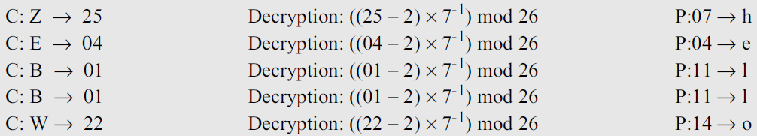
Affine Cipher (contd)
Example : Use the affine cipher to decrypt the message “ZEBBW” with the key pair (7, 2) in modulus 26.
.

Slide 47
Affine Cipher (contd)
Example 3.12
The additive cipher is a special case of an affine cipher in which k1 = 1.
The multiplicative cipher is a special case of affine cipher in which k2 = 0.
.

Slide 48

Cryptanalysis of Affine Cipher
Using chosen-plaintext attack.
Assume that Eve intercepts the following ciphertext:
Eve also very briefly obtains access to Alice’s computer and has only enough time to type a two-letter plaintext: “et”.
She then tries to encrypt the short plaintext using two different algorithms, because she is not sure which one is the affine cipher.
.

Slide 49


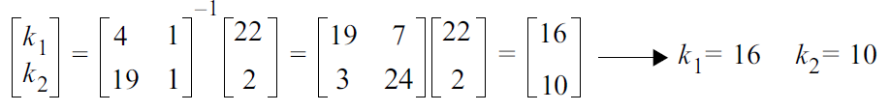
Cryptanalysis of Affine Cipher
Using chosen-plaintext attack.
.

Slide 50
To find the key, Eve uses the following strategy:
a. Eve knows that if the first algorithm is affine, she can construct the following two equations based on the first data set.
These two congruence equations can be solved and the values of k1 and k2 can be found.
However, this answer is not acceptable because k1 = 16 cannot be the first part of the key. Its value, 16, does not have a multiplicative inverse in Z₂₆*.
.

Slide 51

b. Eve now tries the result of the second set of data.
Square matrix and its inverse are the same.
Now she has k1 = 11 and k2 = 4.
This pair is acceptable because k1 has a multiplicative inverse in Z₂₆∗.
She tries the pair of keys (19, 22), which are the inverse of the pair (11, 4), to decipher the message.
The plaintext is
.

Slide 52
Monoalphabetic Substitution Cipher
Additive, multiplicative, and affine ciphers have small key domains, they are very vulnerable to brute-force attack.
After Alice and Bob agreed to a single key, that key is used to encrypt each letter in the plaintext or decrypt each letter in the ciphertext.
In other words, the key is independent from the letters being transferred.
.

Slide 53
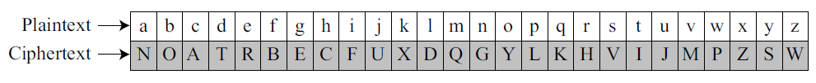
Monoalphabetic Substitution Cipher (contd)
A better solution is to create a mapping between each plaintext character and the corresponding ciphertext character.
Alice and Bob can agree on a table showing the mapping for each character.
.

Slide 54
Monoalphabetic Substitution Cipher (contd)
ciphertext is
Mapping table
.

Slide 55
Cryptanalysis
The size of the key space is 26! (almost 4×10²⁶).
Brute-force attack is difficult
The monoalphabetic ciphers do not change the frequency of characters in the ciphertext, which makes the ciphers vulnerable to statistical attack.
.

Slide 56
Polyalphabetic Ciphers
Each occurrence of a character may have a different substitute.
Relationship between a character in the plaintext to a character in the ciphertext is one-to-many.
Advantage of hiding the letter frequency of the underlying language.
.

Slide 57
Polyalphabetic Ciphers (contd)
Here each ciphertext character dependent on both the corresponding plaintext character and the position of the plaintext character in the message.
key stream k = (k₁, k₂, k₃,…)
k_{i} is used to encipher the i^{th} character in the plaintext to create the i^{th} character in the ciphertext.
.

Slide 58
Autokey Cipher
simple polyalphabetic cipher called the autokey cipher.
In this cipher, the key is a stream of subkeys, in which each subkey is used to encrypt the corresponding character in the plaintext.
First subkey is a predetermined value secretly agreed upon by Alice and Bob.
Second subkey is the value of the first plaintext character (between 0 and 25).
Third subkey is the value of the second plaintext. And so on.
.

Slide 59
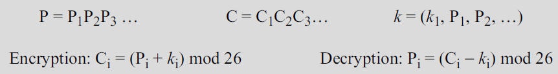
Autokey Cipher
Autokey implies that the subkeys are automatically created from the plaintext cipher characters during the encryption process.
.

Slide 60
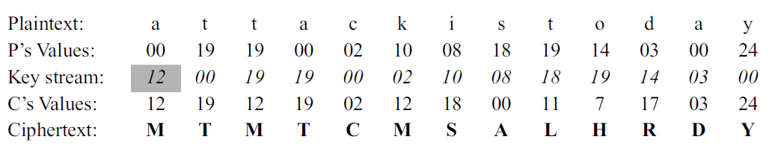
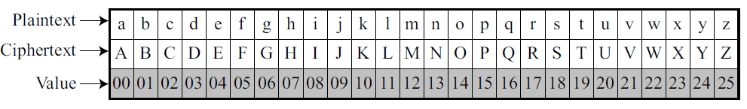
Example : Assume that Alice and Bob agreed to use an autokey cipher with initial key value k₁= 12.
message “Attack is today” and K1=12
.

Slide 61
Cryptanalysis
Hides the single-letter frequency statistics of the plaintext.
It is still as vulnerable to the brute-force attack as the additive cipher.
The first subkey can be only one of the 25 values (1 to 25).
Need polyalphabetic ciphers that not only hide the characteristics of the language but also have large key domains.
.

Slide 62
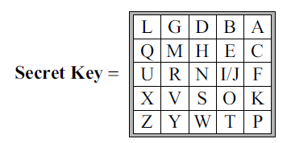
Playfair Cipher
Playfair cipher used by the British army during World War I.
Secret key in this cipher is made of 25 alphabet letters arranged in a 5× 5 matrix (letters I and J are considered the same when encrypting).
Different arrangements of the letters in the matrix can create many different secret keys.
Here dropped the letters in the matrix diagonally starting from the top right-hand corner.
An example of a secret key in the Playfair cipher
.

Slide 63
Playfair Cipher (contd)
Before encryption:
if the two letters in a pair are the same, a bogus letter is inserted to separate them.
After inserting bogus letters, if the number of characters in the plaintext is odd, one extra bogus character is added at the end to make the number of characters even.
.

Slide 64
Playfair Cipher (contd)
The cipher uses three rules for encryption:
If the two letters in a pair
are located in the same row of the secret key | corresponding encrypted character for each letter is the next letter to the right in the same row (with wrapping to the beginning of the row if the plaintext letter is the last character in the row).
are located in the same column of the secret key | corresponding encrypted character for each letter is the letter beneath it in the same column (with wrapping to the beginning of the column if the plaintext letter is the last character in the column).
are not in the same row or column of the secret | corresponding encrypted character for each letter is a letter that is in its own row but in the same column as the other letter
.

Slide 65
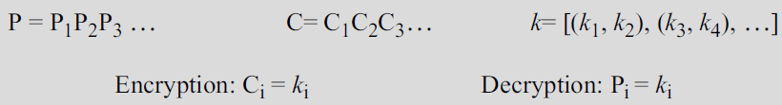
Playfair Cipher (contd)
The key is a stream of subkeys in which the subkeys are created two at a time.
Encryption algorithm takes a pair of characters from the plaintext and creates a pair of subkeys by following the above-mentioned rules.
The key stream depends on the position of the character in the plaintext.
.

Slide 66

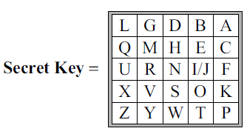
Playfair Cipher (contd)
Example : Encrypt the plaintext “hello” using the key in Figure 3.13.
When we group the letters in two-character pairs, we get “he, ll, o”.
We need to insert an x between the two l’s (els), giving “he, lx, lo”.
We have
The cipher is actually a polyalphabetic cipher
Figure 3.13
.

Slide 67
Cryptanalysis of a Playfair Cipher
Brute-force attack on a Playfair cipher is very difficult.
The size of the key domain is 25! (factorial 25).
In addition, the encipherment hides the single-letter frequency of the characters.
.

Slide 68
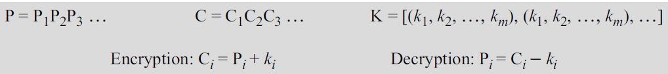
Vigenère Cipher
Key stream is a repetition of an initial secret key stream of length m, where we have 1 ≤ m ≤ 26.
The cipher can be described as follows
where (k₁, k₂, …, k_{m}) is the initial secret key agreed to by Alice and Bob.
.

Slide 69
Vigenère Cipher
The Vigenère key stream does not depend on the plaintext characters; it depends only on the position of the character in the plaintext.
Vigenère is pronounced as vee-jen-air
.

Slide 70
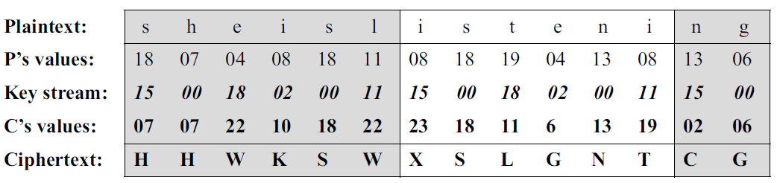
Vigenère Cipher
Encrypt the message “She is listening” using the 6-character keyword “PASCAL”.
The initial key stream is (15, 0, 18, 2, 0, 11). The key stream is the repetition of this initial key stream (as many times as needed).
.

Slide 71
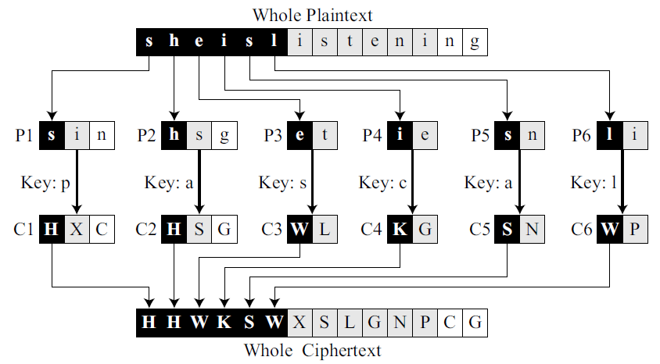
Example 3.17
Vigenère cipher can be seen as combinations of m additive ciphers.
There are m pieces of the plaintext, each encrypted with a different key, to make m pieces of ciphertext.
.

Slide 72
We can say that the additive cipher is a special case of Vigenère cipher in which m = 1.
.

Slide 73
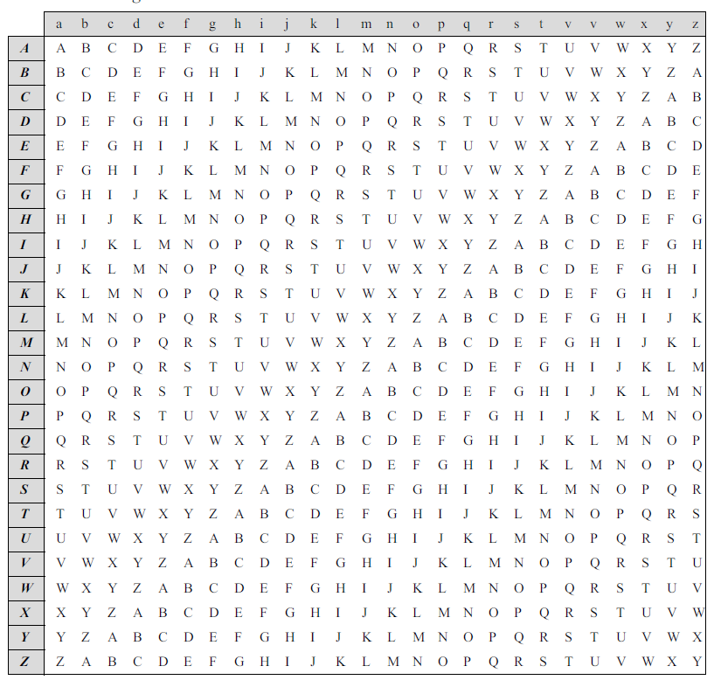
Vigenère Tableau
Another way to look at Vigenere ciphers is through what is called a Vigenère tableau shown in Table 3.3.
A Vigenere tableau
First row shows the plaintext character to be encrypted.
First column contains the characters to be used by the key.
Rest of the tableau shows the ciphertext characters.
.

Slide 74
Vigenère Tableau (contd)
Example: plaintext “she is listening” Key : “PASCAL”
Find “s” in the first row, “P” in the first column, the cross section is the ciphertext character “H”.
Find “h” in the first row and “A” in the second column, the cross section is the ciphertext character “H”.
.

Slide 75
Hill cipher
Here the plaintext is divided into equal-size blocks.
Blocks are encrypted one at a time in such a way that each character in the block contributes to the encryption of other characters in the block.
Hill cipher belongs to a category of ciphers called block ciphers.
Other ciphers studied so far belong to the category called stream ciphers.
.

Slide 76
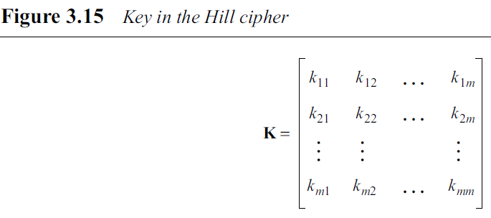
Hill cipher
In a Hill cipher, the key is a square matrix of size m × m in which m is the size of the block.
If we call the key matrix K, each element of the matrix is k_{i,j} as shown in Figure 3.15.
.

Slide 77
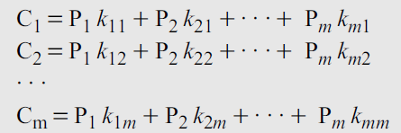
Hill cipher (contd)
Let us show how one block of the ciphertext is encrypted.
Let m characters in the plaintext block P1, P2, …, Pm.
The corresponding characters in the ciphertext block are C1, C2, …, Cm.
Then
.

Slide 78
Hill cipher (contd)
Each ciphertext character such as C1 depends on all plaintext characters in the block (P1, P2, …, Pm).
Not all square matrices have multiplicative inverses in Z₂₆, so Alice and Bob should be careful in selecting the key.
The key matrix in the Hill cipher needs to have a multiplicative inverse.
.

Slide 79
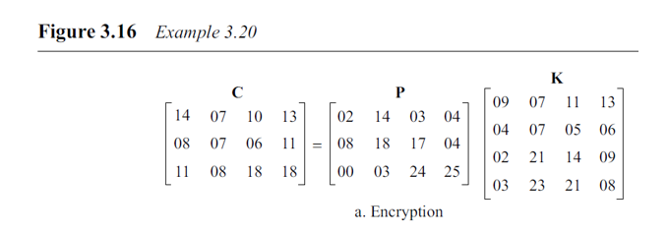
Hill cipher (contd)
Example 3.20
The plaintext is an l × m matrix in which l is the number of blocks.
The plaintext “code is ready” can make a 3 × 4 matrix when adding extra bogus character “z” to the last block and removing the spaces.
The ciphertext is “OHKNIHGKLISS”.
Bob can decrypt the message using the inverse of the key matrix.
.

Slide 80
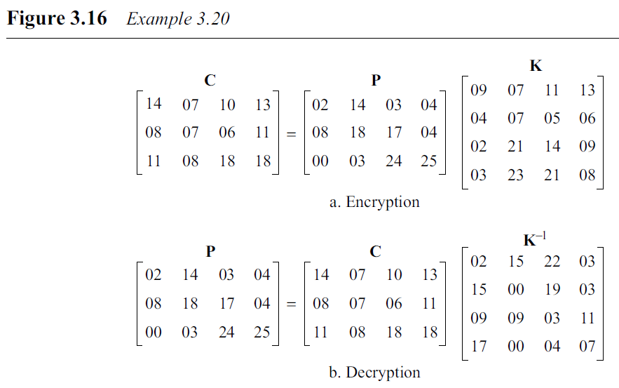
Hill cipher (contd)
.

Slide 81
3.3 TRANSPOSITION CIPHERS
A transposition cipher does not substitute one symbol for another, instead it changes the location of the symbols.
A symbol in the first position of the plaintext may appear in the tenth position of the ciphertext.
A symbol in the eighth position in the plaintext may appear in the first position of the ciphertext.
Transposition cipher reorders (transposes) the symbols.
.

Slide 82
Keyless Transposition Ciphers
Keyless transposition ciphers is the Simple transposition ciphers.
There are two methods for permutation of characters.
First method: the text is written into a table column by column and then transmitted row by row.
Second method: the text is written into the table row by row and then transmitted column by column.
.

Slide 83

Example : A good example of a keyless cipher using the first method is the rail fence cipher.
Here plaintext is arranged in two lines as a zigzag pattern ( column by column); the ciphertext is created reading the pattern row by row.
Example : message “Meet me at the park”
ciphertext is : “MEMATEAKETETHPR”
The cryptanalysis of the ciphertext would be very easy for Eve
.

Slide 84
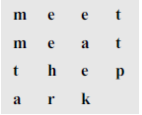
Example 3.23
Alice and Bob can agree on the number of columns and use the second method.
Alice writes the same plaintext, row by row, in a table of four columns.
cipher text : “MMTAEEHREAEKTTP”
.

Slide 85

The following shows the permutation of each character in the plaintext into the ciphertext based on the positions.
second character in the plaintext has moved to the fifth position in the ciphertext;
Third character has moved to the ninth position; and so on.
Although the characters are permuted, there is a pattern in the permutation: (01, 05, 09, 13), (02, 06, 10, 13), (03, 07, 11, 15), and (08, 12).
In each section, the difference between the two adjacent numbers is 4.
.

Slide 86
Keyed Transposition Ciphers
The keyless ciphers permute the characters by using writing plaintext in one way (row by row, for example) and reading it in another way (column by column, for example).
The permutation is done on the whole plaintext to create the whole cipher text.
Another method : divide the plaintext into groups of predetermined size, called blocks, and then use a key to permute the characters in each block separately.
.

Slide 87

Example 3.25
message “Enemy attacks tonight” .
Example: groups of 5 characters and then permute the characters in each group.
Grouping after adding a bogus character at the end to make the equal size group.
The key used for encryption and decryption is a permutation key.
3rd character in the plaintext block becomes the first character in the ciphertext block; the first character in the plaintext block becomes the second character in the ciphertext block; and so on.
.

Slide 88
The permutation yields
Alice sends the ciphertext “EEMYNTAACTTKONSHITZG” to Bob.
Bob divides the ciphertext into 5-character groups and, using the key in the reverse order, finds the plaintext.
.

Slide 89
Combining Two Approaches
Encryption or decryption is done in three steps.
First, the text is written into a table row by row.
Second, the permutation is done by reordering the columns.
Third, the new table is read column by column.
The first and third steps provide a keyless global reordering; the second step provides a blockwise keyed reordering.
These types of ciphers are often referred to as keyed columnar transposition ciphers or just columnar transposition ciphers.
.

Slide 90
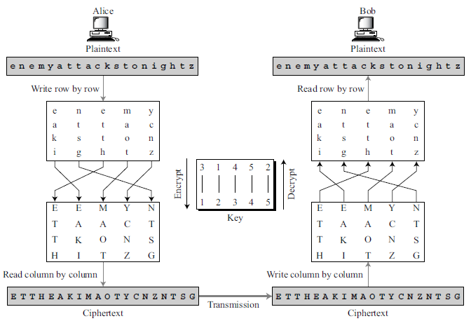
Combining Two Approaches
Example 3.26: Encryption of “Enemy attacks tonight”
.

Slide 91
Using Matrices
The plaintext and cipher text are l × m matrices representing the numerical values
of the characters;
the keys are square matrices of size m × m.
In this case is the inverse of the encryption matrix, there is no need to invert the matrix, the encryption key matrix can simply be transposed to get the decryption key matrix.
.

Slide 92
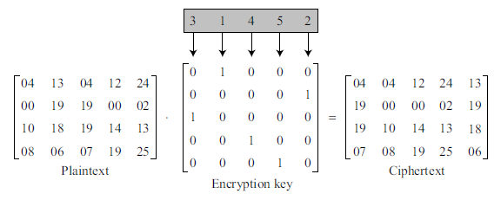
Example 3.27
Note that the matrix multiplication provides only the column permutation of the transposition;
Representation of the key as a matrix in the transposition cipher
.

Slide 93
Cryptanalysis of Transposition Ciphers
Transposition ciphers are vulnerable to several kinds of ciphertext-only attacks.
Statistical Attack
A transposition cipher does not change the frequency of letters in the ciphertext;
So the first attack that can be applied is single-letter frequency analysis.
However, transposition ciphers do not preserve the frequency of digrams and trigrams. This means that Eve cannot use these tools.
.

Slide 94
Brute-Force Attack
Eve can try all possible keys to decrypt the message.
Number of keys can be huge (1! + 2! + 3! + . . . + L!), where L is the length of the ciphertext.
A better approach is to guess the number of columns. Eve knows that the number of columns divides L.
For example, if the length of the cipher is 20 characters, .
the number of columns can be a combination of these factors (1, 2, 4, 5, 10, 20).
The first (only one column) is out of the question and the last (only one row) is unlikely.
.

Slide 95
Example 3.28
ciphertext message “EEMYNTAACTTKONSHITZG”.
Message length L = 20. Number of columns can be 1, 2, 4, 5, 10, or 20.
If the number of columns is 2.
Two permutations are (1, 2) and (2, 1).
The first one means there would be no permutation.
Eve tries the second one.
Eve divides ciphertext into 2-character units: “EE MY NT AA CT TK ON SH IT ZG”.
She then tries to permute each of these getting “ee ym nt aa tc kt no hs ti gz”,
which does not make sense.
.

Slide 96
Example 3.28
ciphertext message “EEMYNTAACTTKONSHITZG”.
Message length L = 20. Number of columns can be 1, 2, 4, 5, 10, or 20.
b. If the number of columns is 4, there are 4! = 24 permutations.
The first one (1 2 3 4) means there would be no permutation.
Eve needs to try the rest. After trying all 23 possibilities, Eve finds no plaintext that makes sense.
c. If the number of columns is 5, there are 5! = 120 permutations.
The first one (1 2 3 4 5) means there would be no permutation.
Eve needs to try the rest.
The permutation (2 5 1 3 4) yields a plaintext “enemyattackstonightz” that makes sense after removing the bogus letter z and adding spaces
.

Slide 97
Pattern Attack
The ciphertext created from a keyed transposition cipher has some repeated patterns. Example:
The 1st character in the ciphertext comes from the 3rd character in the plaintext. The 2nd character in the ciphertext comes from the 8th character in the plaintext and so on.
There is a pattern: We have five groups: (3, 8, 13, 18), (1, 6, 11, 16), (4, 9, 14, 19), (5, 10, 15, 20), and (2, 7, 12, 17). In all groups, the difference between the two adjacent numbers is 5.
If Eve knows or can guess the number of columns (5 in this case), she can organize the ciphertext in groups of four characters. Permuting the groups can provide the clue to finding the plaintext.
.

Slide 98
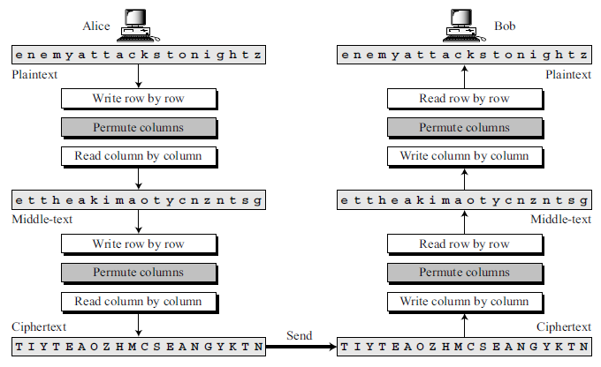
Double Transposition Ciphers
Double transposition ciphers can make the job of the cryptanalyst difficult.
An example of such a cipher would be the one that repeats twice the algorithm used for encryption and decryption.
A different key can be used in each step, but normally the same key is used.
.

Slide 99
Although, the cryptanalyst can still use the single-letter frequency attack on the ciphertext, a pattern attack is now much more difficult. The pattern analysis of the text shows
.

Slide 100
3.4 STREAM AND BLOCK CIPHERS
Symmetric ciphers into two broad categories: stream ciphers and block ciphers.
Although the definitions are normally applied to modern ciphers, this categorization also applies to traditional ciphers.
.

Slide 101

Stream Ciphers
In a stream cipher, encryption and decryption are done one symbol (such as a character or a bit) at a time.
We have a plaintext stream, a ciphertext stream, and a key stream.
.

Slide 102
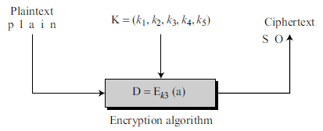
Idea behind a stream cipher.
Characters in the plaintext are fed into the encryption algorithm, one at a time; the ciphertext characters are also created one at a time.
Figure shows the moment where the third character in the plaintext stream is being encrypted using the third value in the key stream. The result creates the third character in the ciphertext stream.
.

Slide 103
The key stream, can be created in many ways.
It may be a stream of predetermined values;
it may be created one value at a time using an algorithm.
The values may depend on the plaintext or ciphertext characters.
The values may also depend on the previous key values.
.

Slide 104

Example 3.30
Additive ciphers can be categorized as stream ciphers.
The key stream is considered as a predetermined stream of keys or K = (k, k, …, k).
Each character in the ciphertext depends only on the corresponding character in the plaintext,
Example 3.31
The monoalphabetic substitution ciphers are also stream ciphers.
Each value of the key stream in this case is the mapping of the current plaintext character to the corresponding ciphertext character in the mapping table.
Example 3.32
Vigenere ciphers are also stream ciphers.
The key stream is a repetition of m values, where m is the size of the keyword.
.

Slide 105
Example 3.33
Dividing stream ciphers based on their key streams.
monoalphabetic vs polyalphabetic.
Additive ciphers are definitely monoalphabetic.
Monoalphabetic substitution ciphers are definitely monoalphabetic.
Vigenere ciphers are polyalphabetic.
.

Slide 106
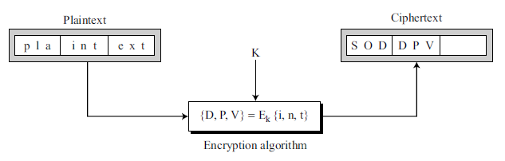
Block Ciphers
In a block cipher, a group of plaintext symbols of size m (m > 1) are encrypted together creating a group of ciphertext of the same size.
Single key is used to encrypt the whole block even if the key is made of multiple values.
.

Slide 107
Example 3.34
Playfair ciphers are block ciphers. The size of the block is m = 2.
Example 3.35
Hill ciphers are block ciphers.
Example 3.36
Every block cipher is a polyalphabetic cipher because each character in a ciphertext block depends on all characters in the plaintext block.
.

Slide 108
.

